Slide 1

Project Title -
Payroll Management System
127 - Snehal Dattatray Kumbhar
128 - Riya Kiran Kamble
130 - Sayali Shankar Gurav
135 - Ankita Ankush Ghunake

Slide 2

Introduction
A Payroll Management System is a software application designed to automate and manage employee salary processing, attendance, deductions, bonuses, and tax calculations. In a Java-based payroll system, the core functionalities include employee data management, salary computation, payslip generation, and report creation. This system ensures accuracy, reduces manual errors, saves time, and maintains confidentiality in salary-related operations. It is essential for HR departments to streamline payroll processes efficiently and in compliance with labor laws and organizational policies.

Slide 3
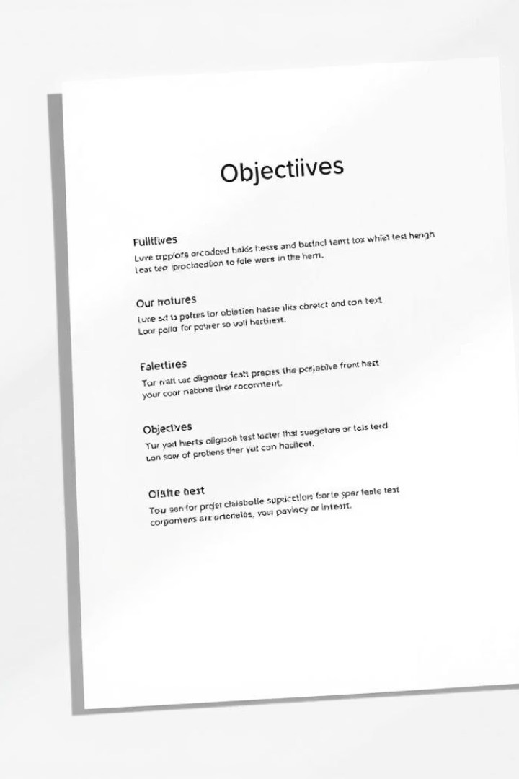
Objectives -
Automate Salary Calculation: To automatically compute employee salaries based on attendance, bonuses, and deductions.
Maintain Employee Records: To securely store and manage employee information including personal, professional, and financial details.
Generate Payslips: To create accurate and timely salary slips and various payroll-related reports.
Ensure Accuracy and Compliance: To reduce human errors and ensure compliance with tax laws and company policies.
Save Time and Improve Efficiency: To streamline payroll operations, reducing manual work and improving overall HR productivity.

Slide 4

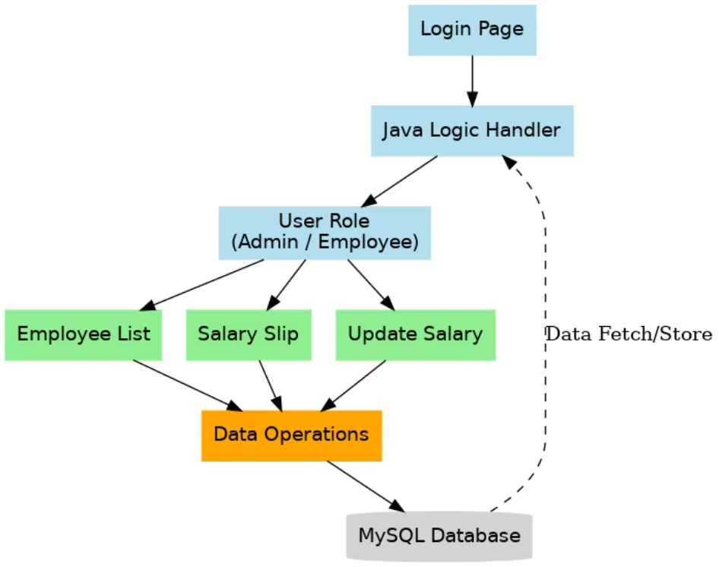
System architecture -
Login and Role Handling: Users access the system through a Login Page, which is managed by a Java Logic Handler that determines their role (Admin or Employee).
Role-Based Access: Depending on the user role, the system provides access to different modules—Employee List, Salary Slip, and Update Salary.
Data Processing: Each module performs specific tasks and communicates with a central Data Operations unit to process data requests.
Database Integration: All data operations (fetching and storing) are carried out through a MySQL Database, ensuring persistent storage and retrieval of employee-related information.

Slide 5
Working of System
1.UI Layer (Java Swing)
Screens: Login, New_Employee, List_Employee, TakeAttendence, pay_slip, Update_salary
Handles user interaction & form submission
Triggers business logic on actions
2.Logic Layer (Java Backend)
Classes: conn.java, Salary.java, Update_salary.java, project.java
Authenticates users, calculates salary, updates data
Communicates with DB via JDBC (conn.java)

Slide 6
3.Database Layer (MySQL)
Tables: employees, attendance, salary, login_users
Stores and manages employee, salary & login data
Logic layer performs SQL operations
System Flow Example Login → Add Employee → Mark Attendance → Generate Slip → Update Salary
Benefits Separation of concerns | Scalable | Easy maintenance

Slide 7
Java Concepts used -
1. OOP Principles Classes & Objects –
Each java models real-world entities (e.g., Employee, Salary) Encapsulation – Private fields with public getters/setters Inheritance – Reusable base/helper classes (if any) Polymorphism – Overloading/overriding in forms or logic
2. Java Swing (GUI) UI built with:
JFrame, JPanel, JButton, JLabel, etc. Event Handling via ActionListener, MouseListener
3.JDBC (Database Access) conn.java uses:
DriverManager, Connection, Statement, ResultSet Handles all CRUD operations with MySQL
4.Exception Handling
For DB errors, input validation, nulls, etc. Uses: try, catch, finally, throw, throws

Slide 8


